Slide 1
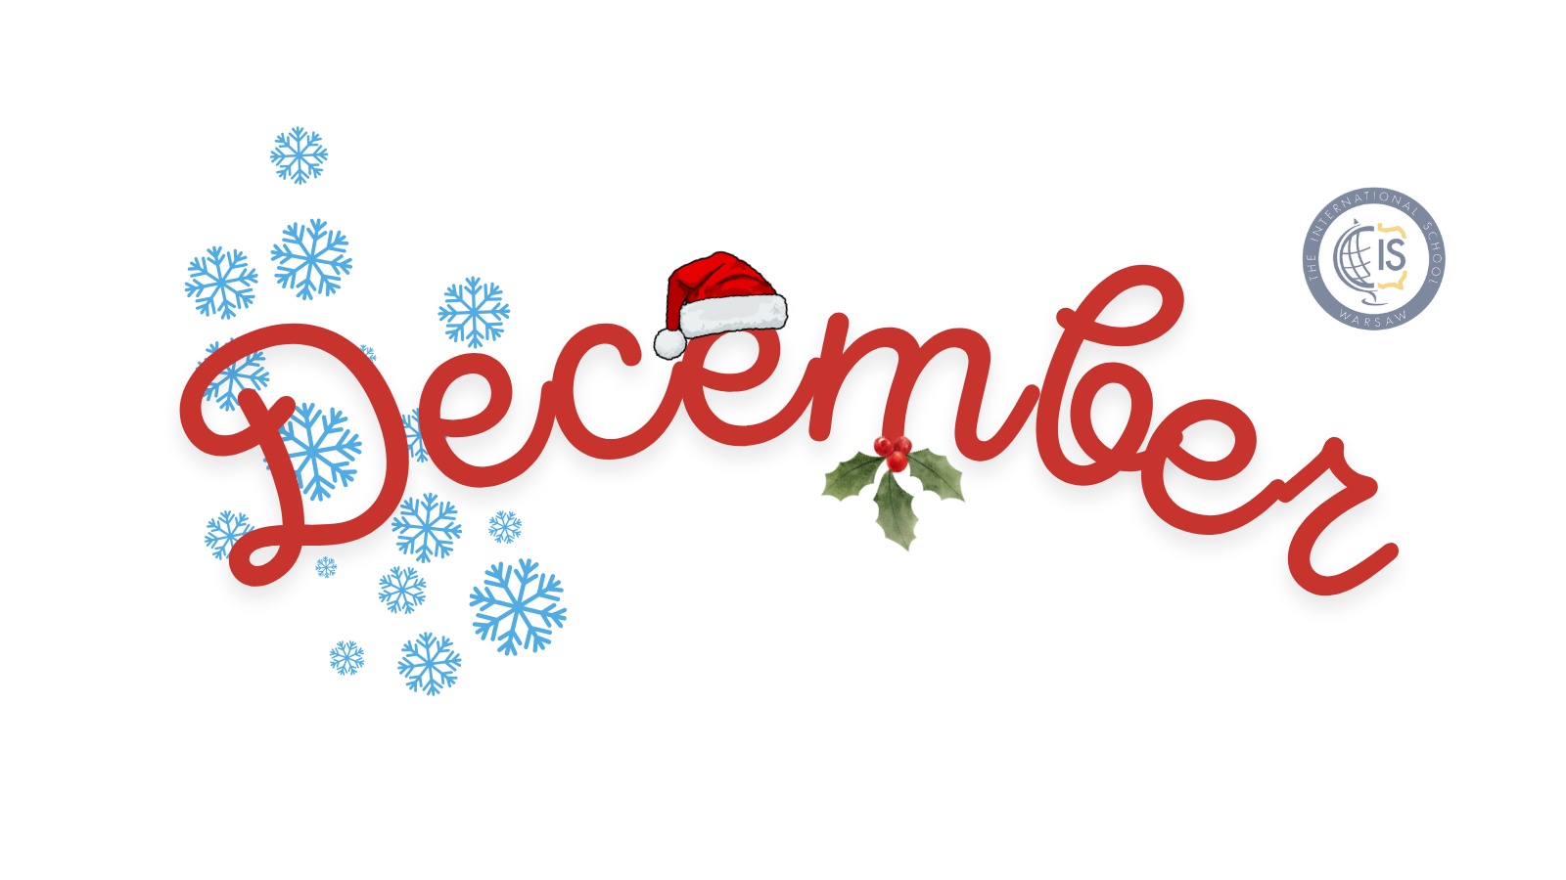
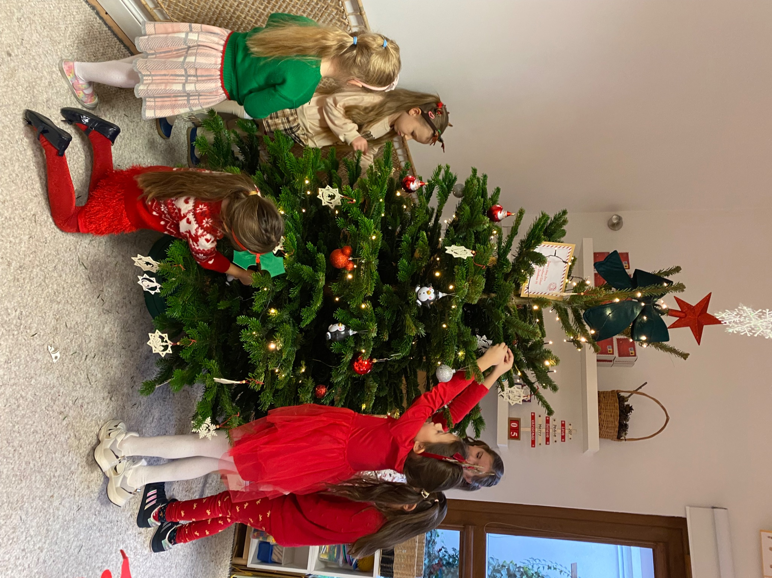
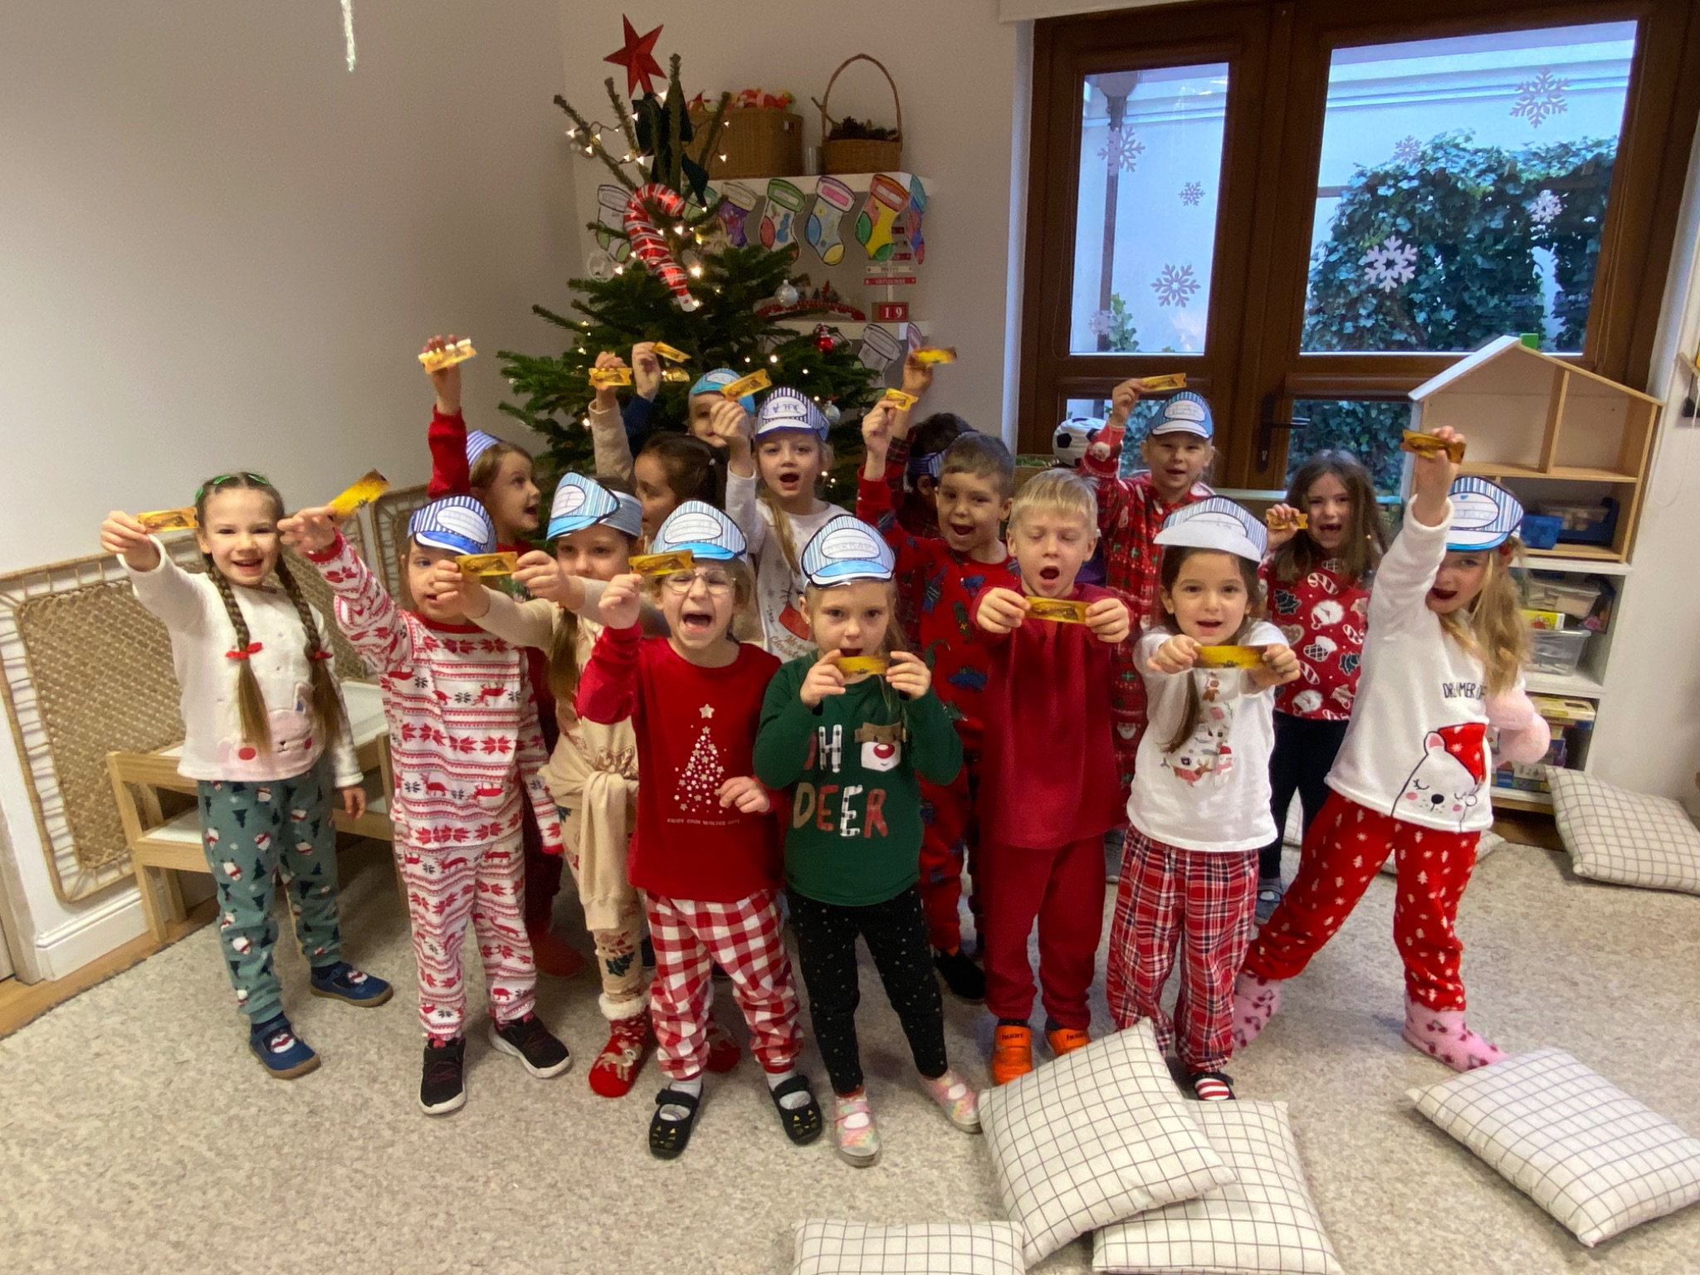
Grade 0 Newsletter - December in Review
Introduction
Christmas break is near! We had a great month celebrating St. Nicholas Day and welcoming the holiday season. We hope you enjoy our first Christmas performance!
Mathematics
We continued addition and subtraction to ten and had practice skip counting! We wrote numbers 11-20 and counted objects to twenty too! We also began problem solving and
Science
We learned more about one of the most colourful birds in the world: peacocks!. Students were asked to draw their most beautiful peacock, using a real feather to decorate their train. The final result turned out great. Next, we also discussed how wind can be used as a source of energy to do work for us.
Language Arts
We completed a mini-study on “The Polar Express” and practiced our spelling of Christmas words like “Santa,” “tree” and “bell!” We continued to build our reading and sight word skills with Christmas games and sentences. We learned about facts and opinions and wrote about our favorite season! Finally, we sorted objects into categories.
Social Studies
This month we learned about Christmas traditions in three different countries: Sweden, the Philippines and Mexico! We colored Filipino “parols,” made crowns for St. Lucia’s Day and listened to the story “T’was Nochebuena.” We took a virtual field trip to see decorations in all three places!
Art
Tis the season of holiday crafts! We wrote a letter to Santa, made tear paper Santas, colored our own paper ornaments. We also made sweet gifts for our parents - get excited for a Christmas party surprise!
Important Dates:
Pictures, pictures, pictures!
December 23rd-31st - Christmas Break (School Closed)
January 1st- New Year’s Day (School Closed)
January 2nd-3rd - Days Off
January 6th - Epiphany (School Closed)
January 27th - Grader 0 Group Parent Meeting
February 3rd-14th - Winter Break

