Slide 1
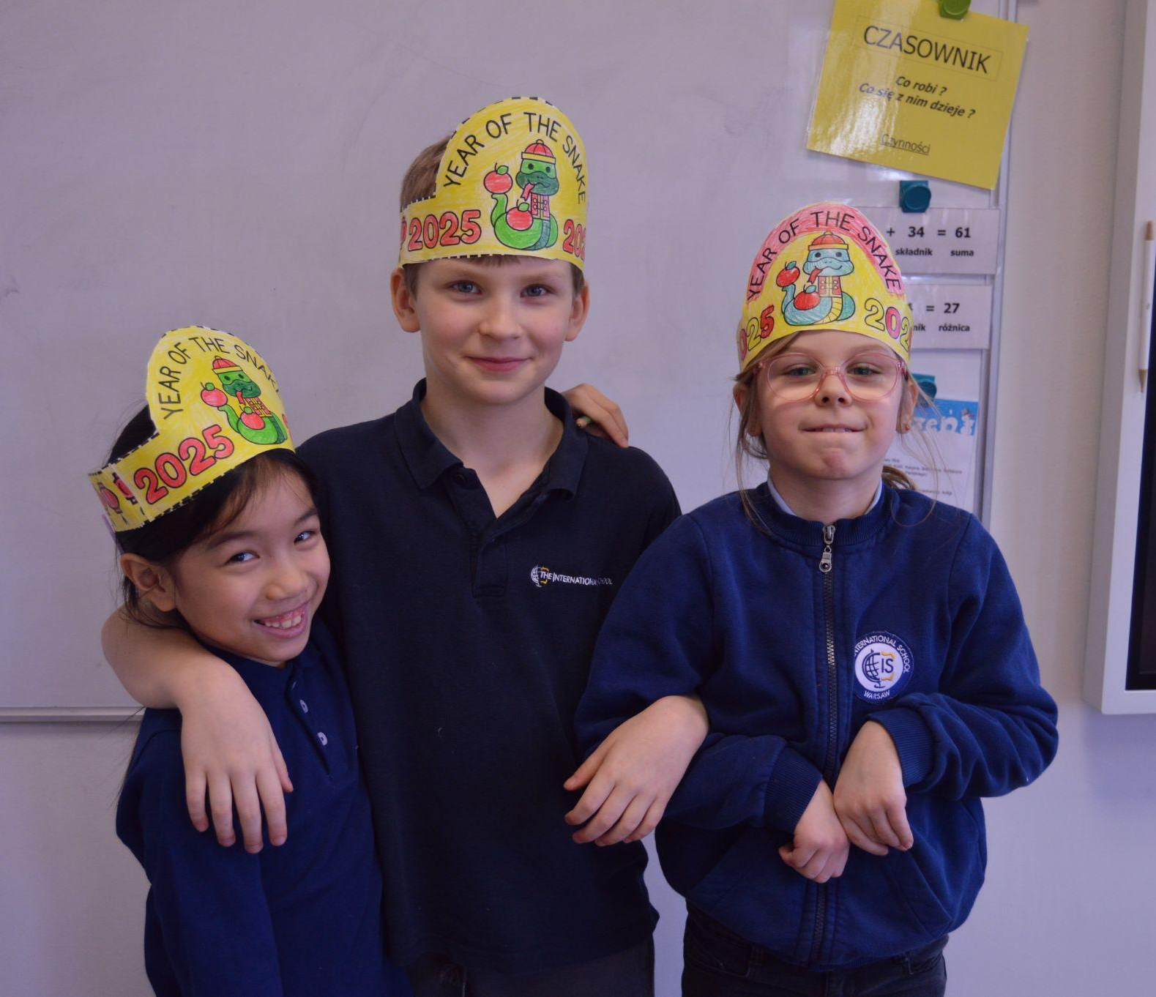
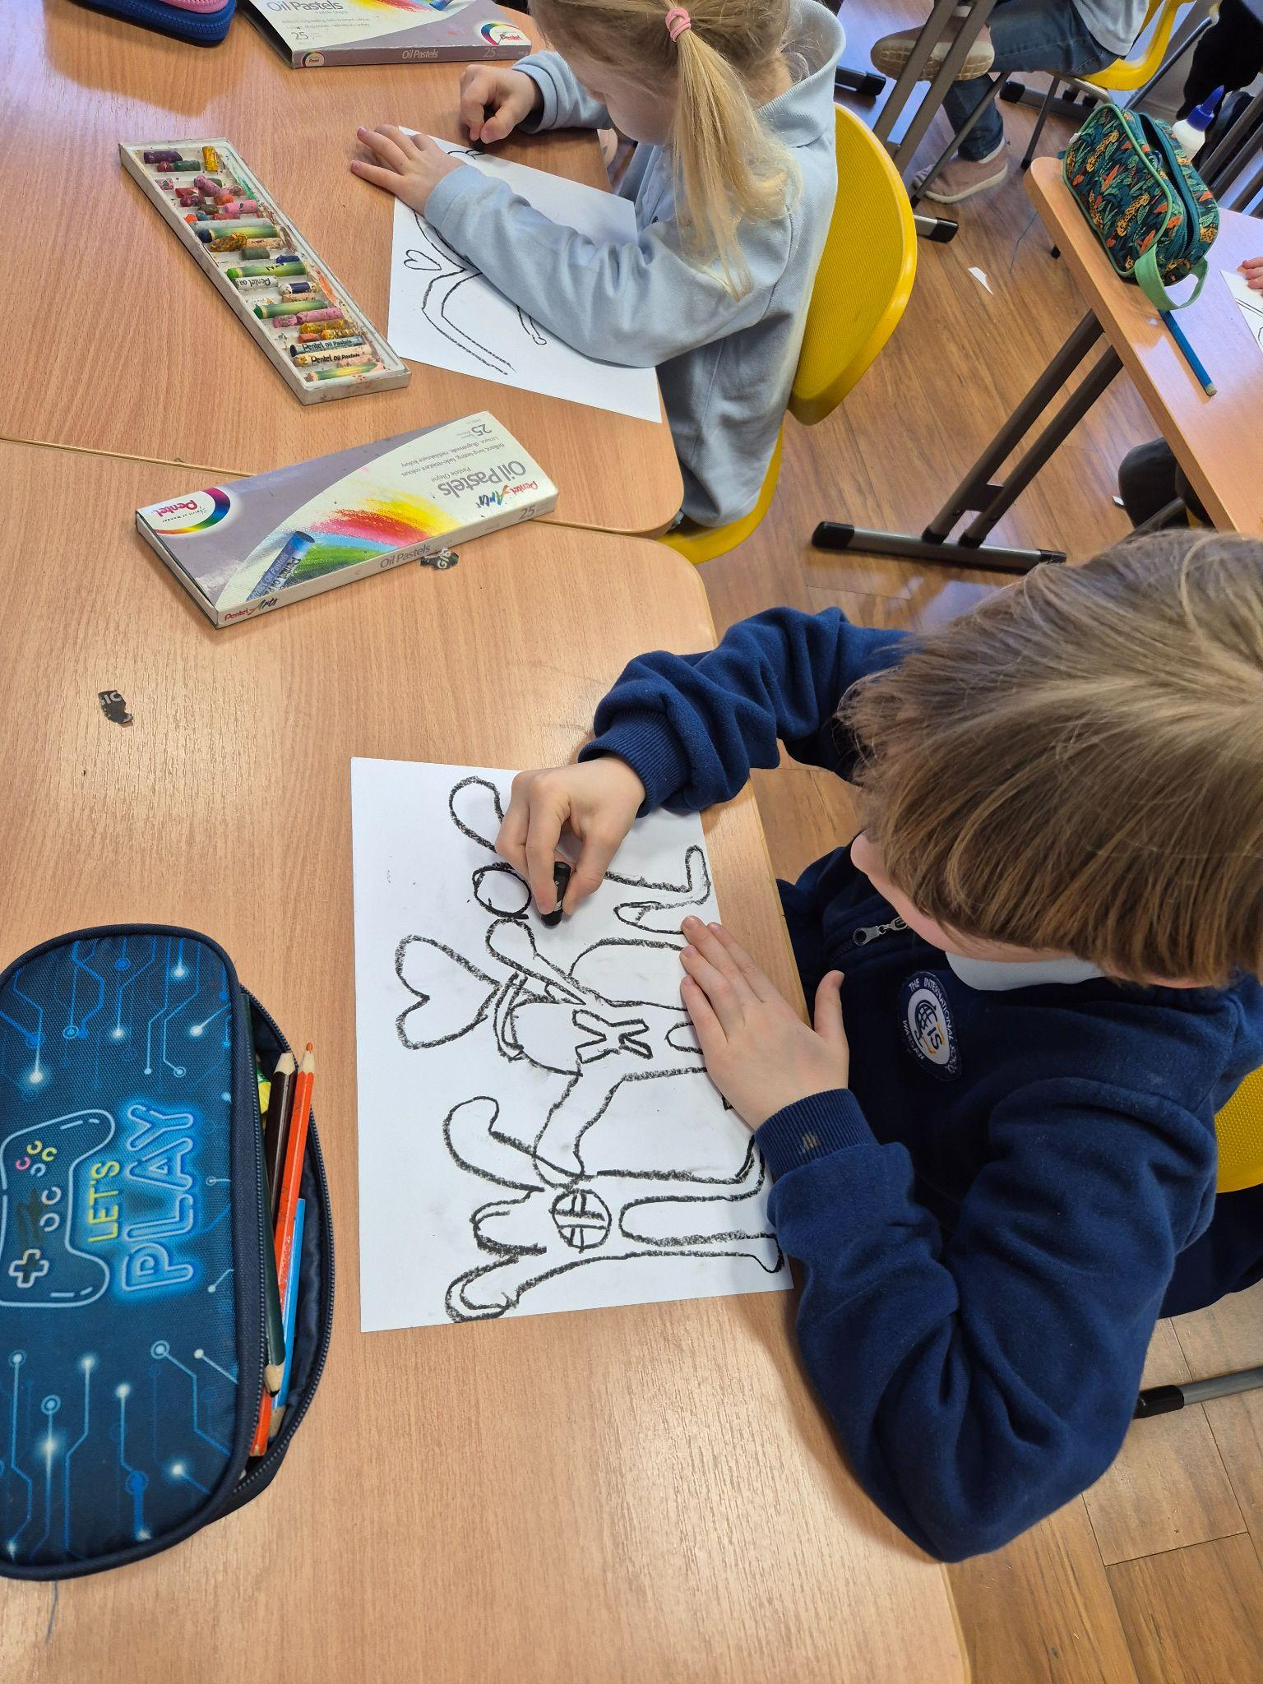
Grade #1 Newsletter - January in Review
Introduction
We welcomed 2025 by finishing up our unit on Celebrations around the world and learning about the Lunar New Year!
Mathematics
We learned how to measure objects using non standard units and and measured objects around the classroom. We also looked at 2D shapes in depth.
Science
This month, we looked at natural and built structures and learned about the different kinds of materials used to make things, like plastic, wood, and metal. Our activities helped us explore how these materials are used to build the objects and structures around us.
Language Arts
We learned about verbs, nouns and adjectives. We wrote a descriptive paragraph about ourselves using adjectives. We also learned the simple present and how to turn sentences into negatives.
Social Studies
We talked about teamwork and how we can become more responsible as we move into the second semester. We also learned the story of Chinese New Year.
Art
Our artist profiles for this month were: Keith Haring where students made artwork in his infamous graffiti style and Georgia O’Keeffe. We also made crafts to celebrate the Lunar New Year.
Pictures, pictures, pictures!
Important Dates:
January 20th - Start of the ‘Going Places’ class project
February 3rd - 14th - Winter Break
March 20th - Spelling Bee (Class round)
March 27th - Spelling Bee (Finals)

